Slide 1

DS Chris Spinks

Slide 2

Tech Innovation and Dark Web Operations
And some other stuff too!!

Slide 3

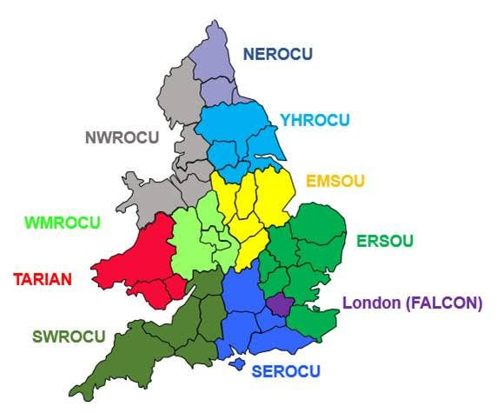

Slide 4

Intern Placement Programme
3 Year programme
Year 1 – Recruitment and placement
Year 2 – Potential for Part Time and finish uni
Year 3 – Employment.
Apply here! https://westyorkshirepolice.tal.net/vx/lang-en-GB/mobile-0/appcentre-3/brand-3/candidate/so/pm/6/pl/1/opp/1977-RC235-Cyber-Crime-Intern-Placement-Prepare-External/en-GB

Slide 5
YHROCU
YHRCCU
Pursue​
Protect​
Prevent ​
Prepare​
RDOT

Slide 6

Who do we support
Yorkshire Forces
UK Law Enforcement
NCA
Europol
F.B.I. / H.S.I.
Industry Partners
Business Resilience Centres

Slide 7
What are we seeing
E2E Encryption
TOR
Hidden Services
Cryptocurrency ( > 4928! )
Cloud infrastructure
Bulletproof Hosting
Huge phishing campaigns
Global fraud $1.7 trillion
Ransomware
…..

Slide 8
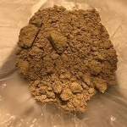
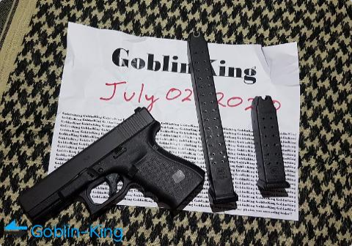
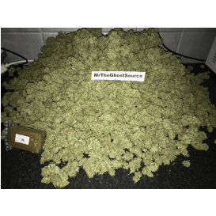
Current Operations – Classified!

Slide 9
Intern Recruitment Process

